Slide 1
Demographics in American Businesses
Emily Atkinson, Elsa Carlson, Ryan Gamilo, and Nolan Thomas

Slide 2
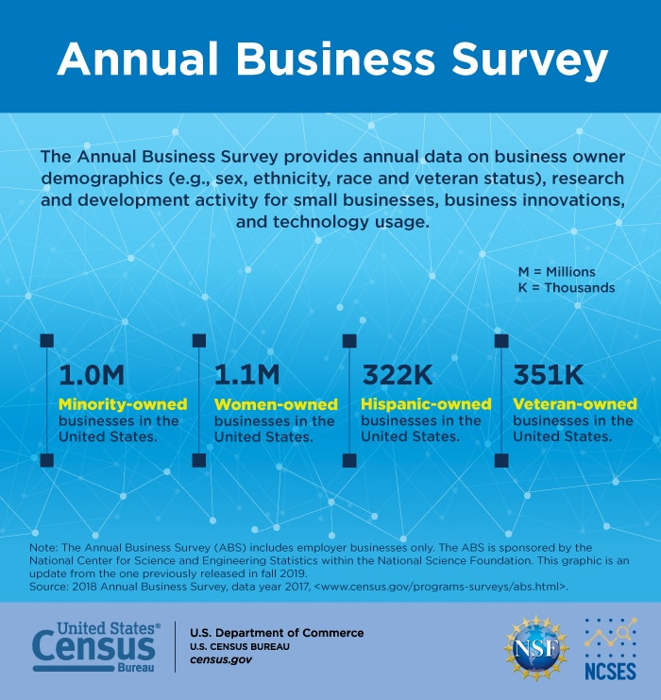
Dataset
Annual Business Survey 2019
“provides information on selected economic and demographic characteristics for businesses and business owners by sex, ethnicity, race, and veteran status” (US Census Bureau, 2022)
Divided into four different data sets: company summary, characteristics, characteristics of business owners, and technology characteristics of businesses.

Slide 3
Focus & Research Questions
Focus: The relationship between different demographic groups and business characteristics
Questions:
Is there a relationship between the race of owners and the race of employees?
Does the demographic makeup for businesses opened before/after 1980s look different?
What does the demographic makeup of employees look like in relation to the longevity of the business?
What is the relationship between the demographic composition of a business and the business’s specialized technology use?

Slide 4
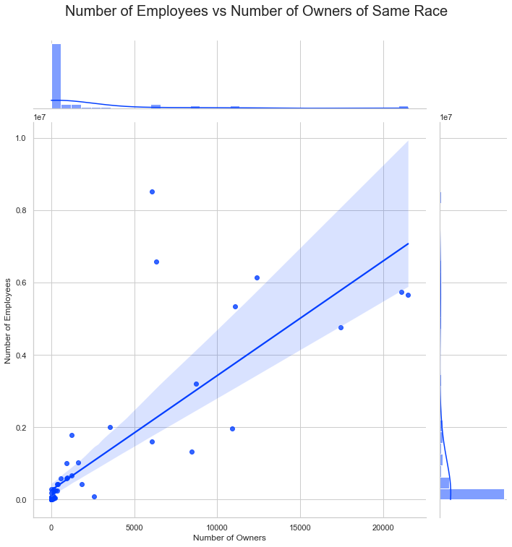
Number of Employees vs Number of Owners of Same Race
Is there a relationship between the race of owners and the race of employees?
Correlation Coefficient:
0.81

Slide 5
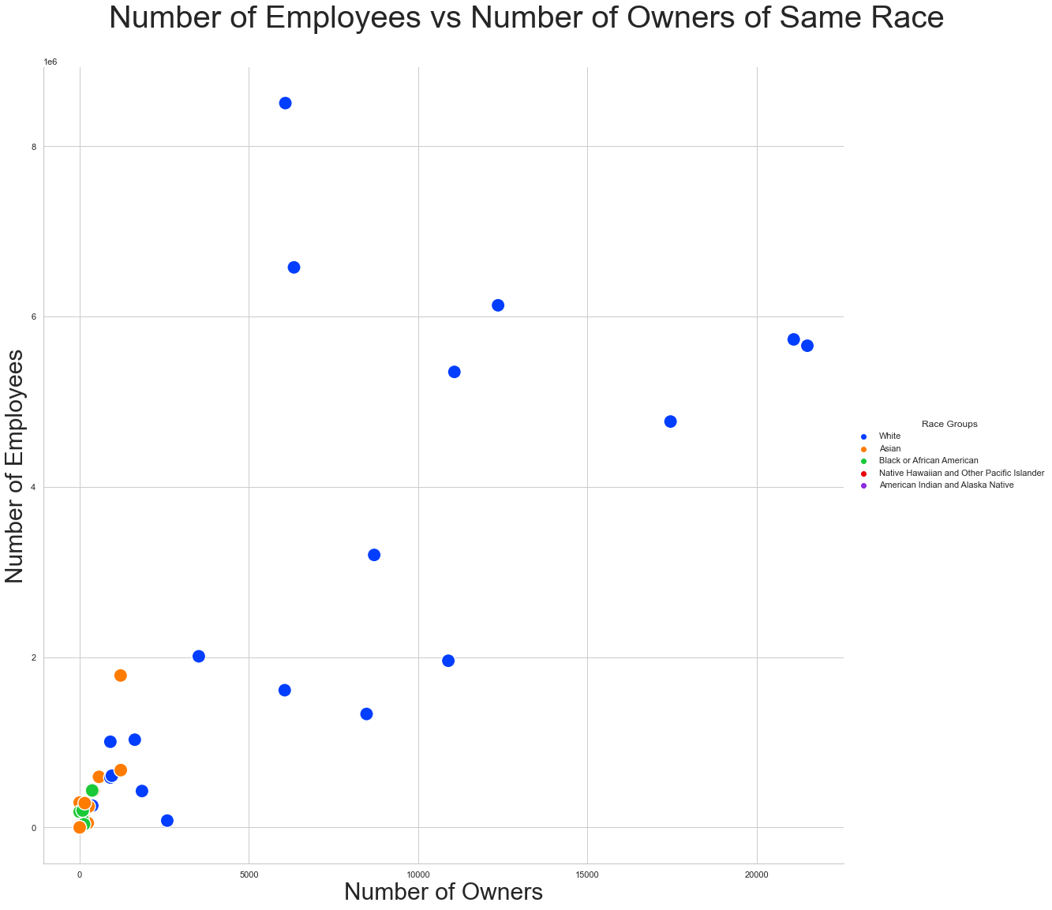
Number of Employees vs Number of Owners of Same Race
Is there a relationship between the race of owners and the race of employees?

Slide 6
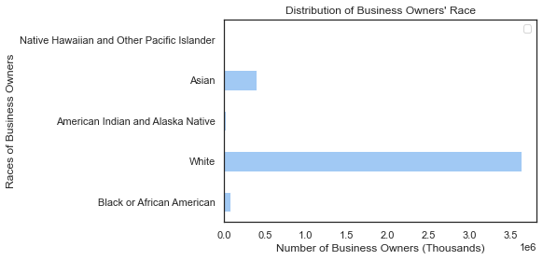
Number of Business Owners by Race
Is there a relationship between the race of owners and the race of employees?

Slide 7
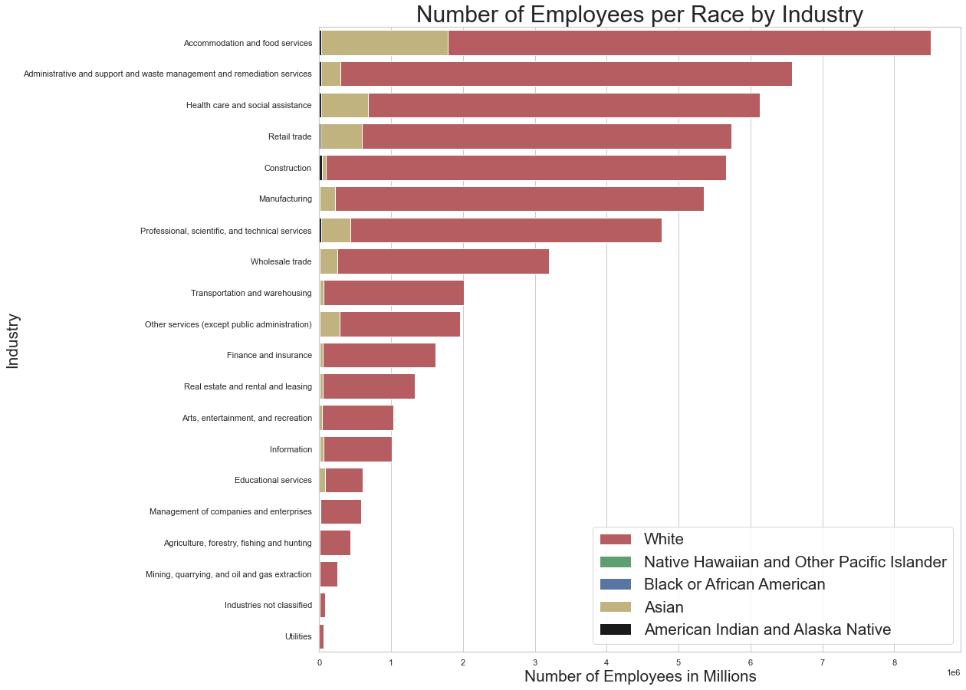
Number of Employees per Race by Industry
Is there a relationship between the race of owners and the race of employees?

Slide 8
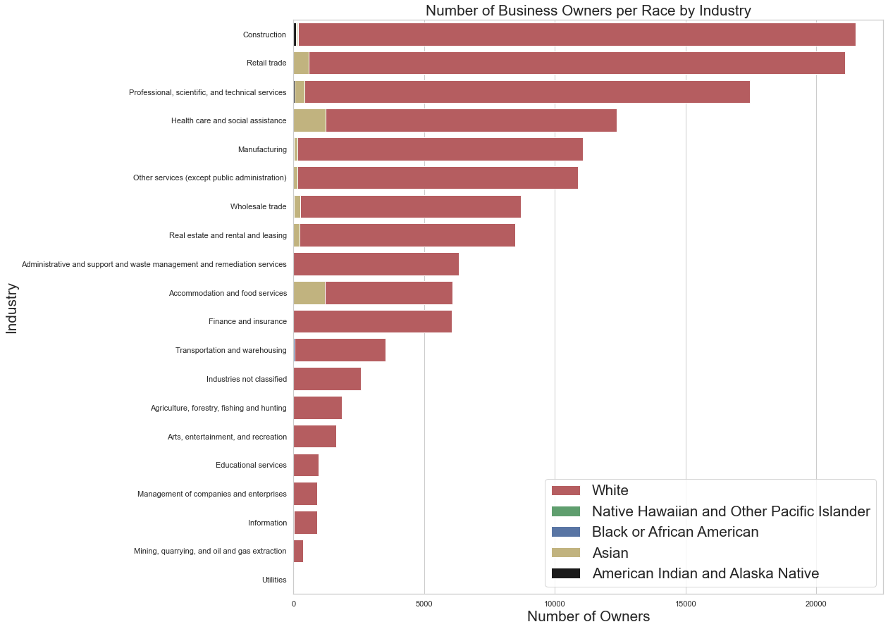
Number of Business Owners per Race by Industry
Is there a relationship between the race of owners and the race of employees?

Slide 9
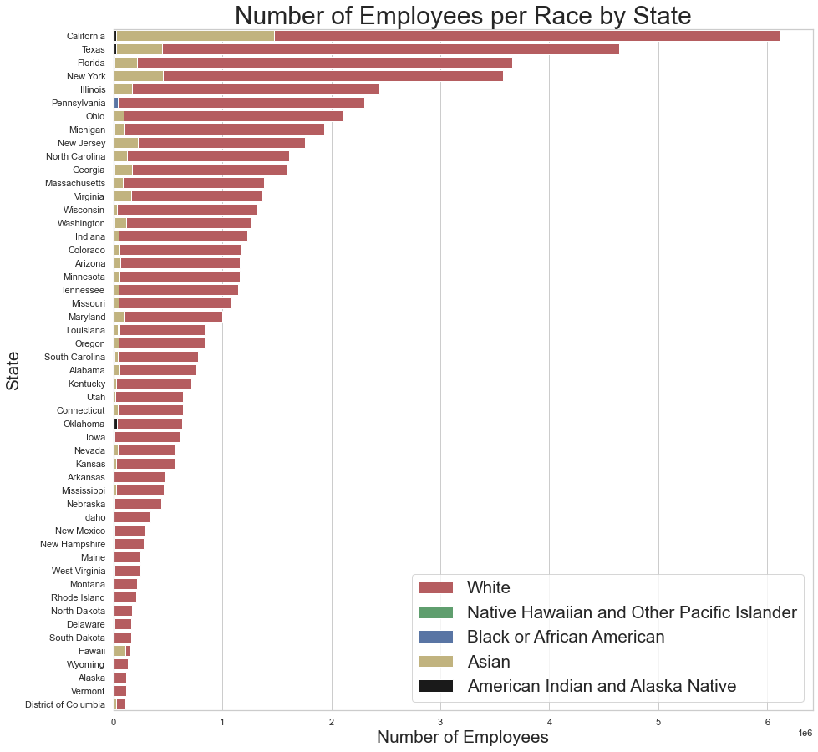
Number of Employees per Race by State
Is there a relationship between the race of owners and the race of employees?

Slide 10
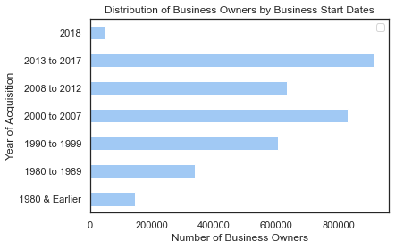
Business Owners by Business Acquisition Date
What is the overall breakdown of when these business owners acquired their business?

Slide 11
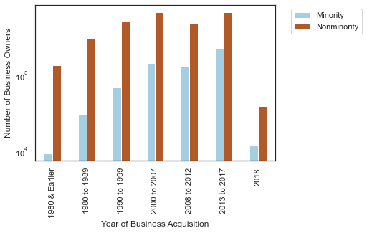
Minority vs Nonminority Business Owners by Business Acquisition Date
What is the racial breakdown of business owners relative to the year they acquired their business?

Slide 12
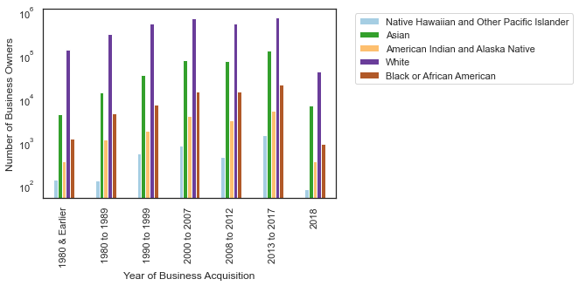
Business Owners by Race & Business Acquisition Date
What is the particular demographic breakdown of business owners’ race relative to when they acquired their business?

Slide 13
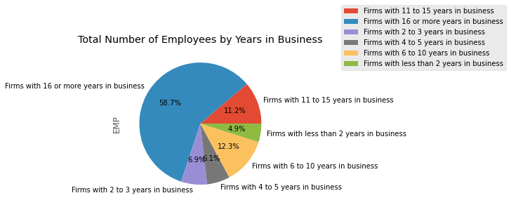
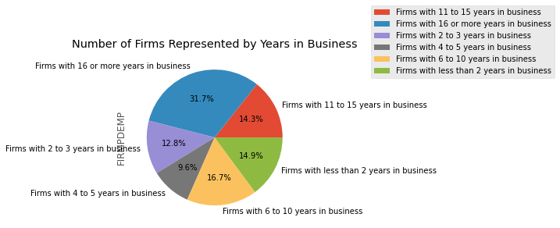
Breakdown of Firms by Years in Business
What does the demographic makeup of employees look like in relation to the longevity of the business?

Slide 14
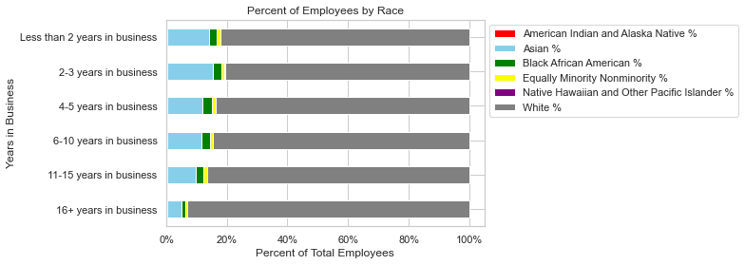
Employee Breakdown by Race and Years in Business
What does the demographic makeup of employees look like in relation to the longevity of the business?

Slide 15
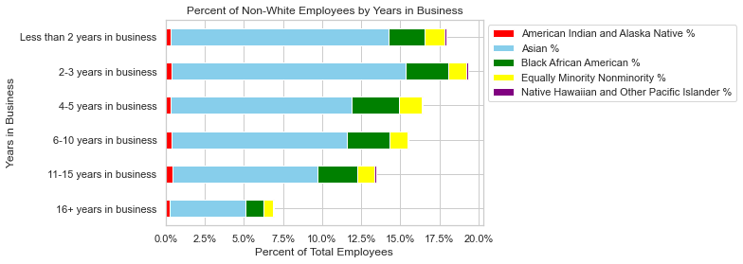
Non-White Employee Breakdown by Race and Years in Business
What does the demographic makeup of employees look like in relation to the longevity of the business?
Notes:
Asians make up 5.7 percent of the United States population while Black Americans make up 13.4 percent of the United States population

Slide 16
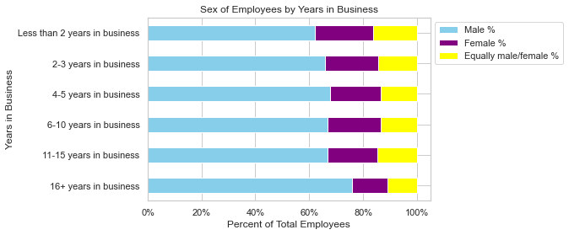
Employee Breakdown by Sex and Years in Business
What does the demographic makeup of employees look like in relation to the longevity of the business?

Slide 17
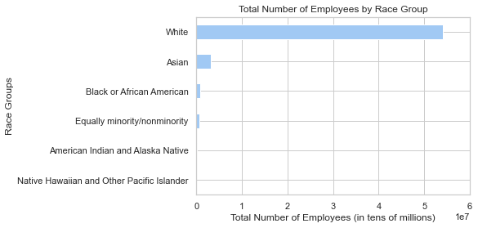
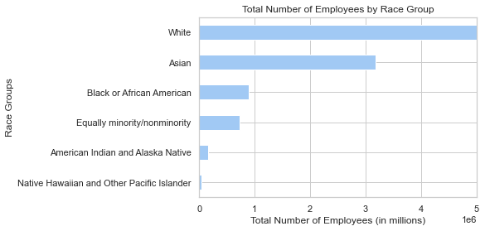
Total Number of Employees by Race Group
What is the relationship between the demographic composition of a business and the business’s specialized technology use?
What is the relationship between the demographic composition of a business and the business’s specialized technology use?
Notes:
The White Race Group has a reported population of approximately 54 million. Contrasted with the approximately 3.2 million for the Asian Race group, we can see the large gap in population demographics of the workforce

Slide 18
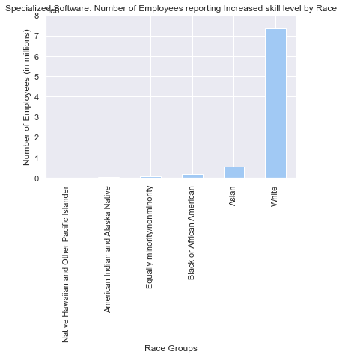
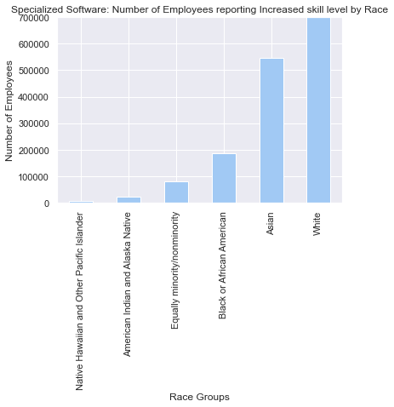
Software Specialization by Race
What is the relationship between the demographic composition of a business and the business’s specialized technology use?
Notes:
In a similar vein, we see the White Race group reporting an increase in skill level due to use of specialized software at around 7.3 million employees. This contrasts with the next largest race group of Asian employees reporting at around 550 thousand.

Slide 19
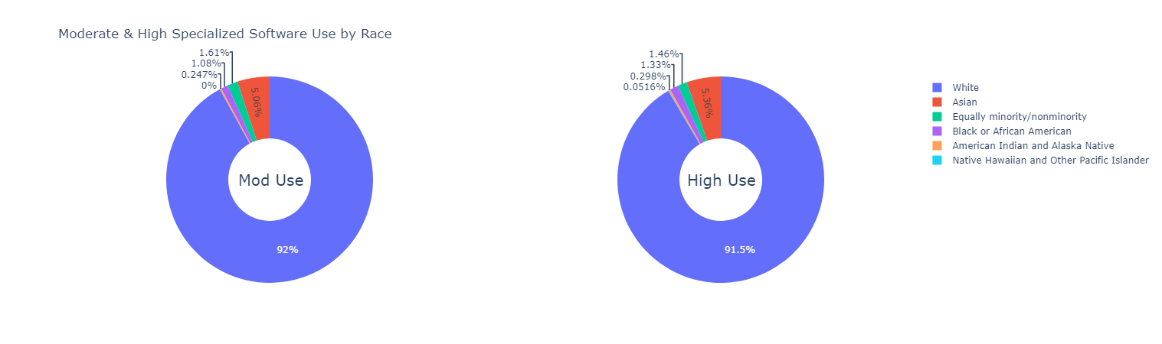
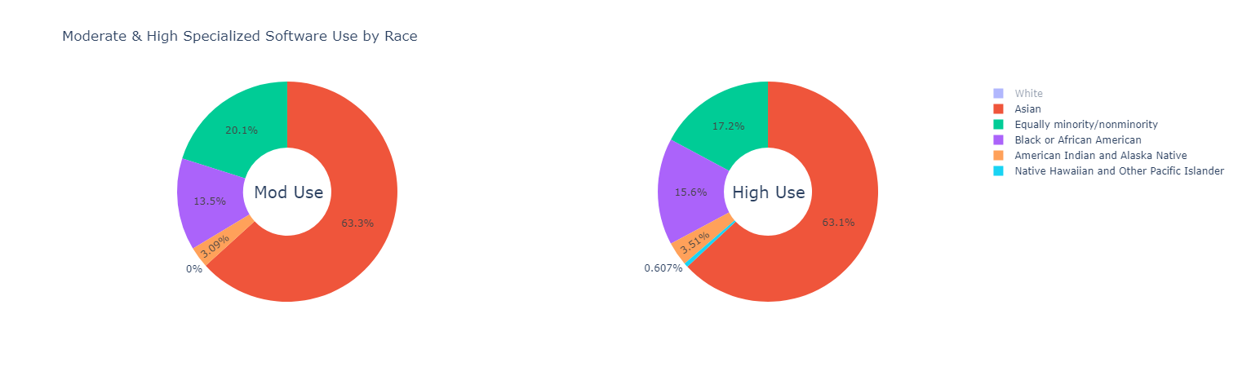
Software Specialization by Race
What is the relationship between the demographic composition of a business and the business’s specialized technology use?
Notes:
Finally, looking at how specialized technology software is used in the workplace, we can see that an overwhelming proportion of survey participants who report moderate or high uses of specialized software are white. The first donut chart represents the moderate to high use of these workforce participants. The remaining 8-8.5% of workforce members can be viewed in greater detail in the lower visualization on the page.

Slide 20
Conclusions
The workforce, from owners to employees, is overwhelmingly white across sectors
This makes it challenging to see the breakdown of non-white owners/employees
The data shows clear disparities but does not tell us why
Further research is needed to dig in to the root causes of these disparities

Slide 21
References
US Census Bureau. (2022, July 25). About the Annual Business Survey (ABS). Census.gov. Retrieved September 5, 2022, from https://www.census.gov/programs-surveys/abs/about.html
United States Census. (2019). Annual Business Survey [Dataset]. https://www.census.gov/data/developers/data-sets/abs.2019.html

